Slide 1
Production Risk Assessment Training
V1 November 2023

Slide 2
Learning objectives
Understand the reasons why we assess risk, including our legal requirements
To be able to identify a range of different hazard identification techniques
Understand the hierarchy of control and its implementation
Become competent in assessing risk levels issuing a semi-quantitative matrix
Understand the requirements to monitor and review risk assessments.

Slide 3
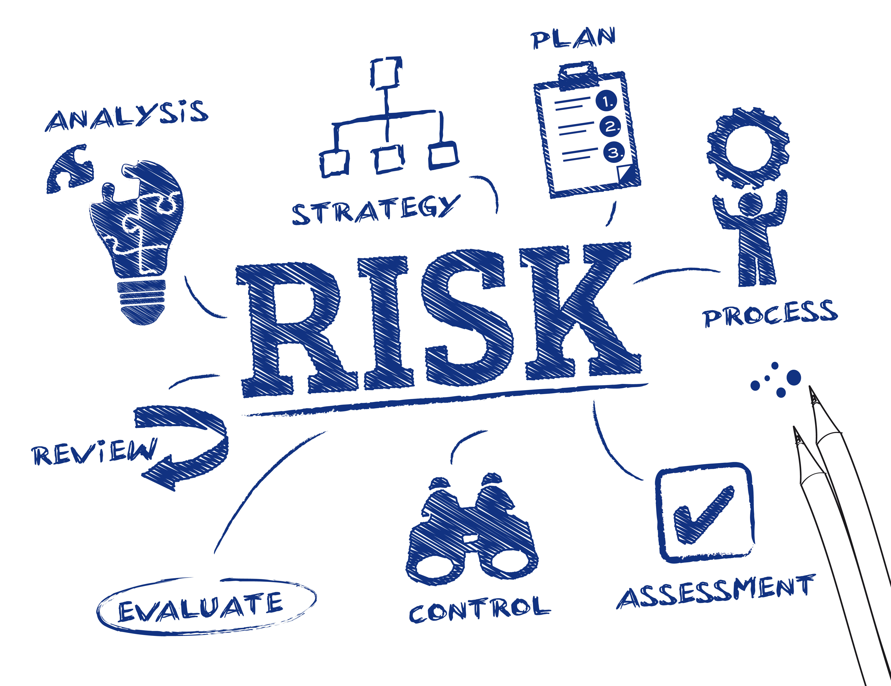
agenda
1
Why Assess risk?
2
Important definitions
3
Legal requirements
4
Five step approach
Notes:
Understand the reasons why we assess risk, including our legal requirements
To be able to identify a range of different hazard identification techniques
Understand the hierarchy of control and its implementation
Become competent in assessing risk levels using a semi-quantitative matrix
Understand the requirements to monitor and review risk assessments

Slide 4



Why assess risk?
Moral
legal
economical
Unacceptability of putting persons at risk
Common law duty of care
Societal Pressures – e.g. Rust shooting
Preventative
Punitive
Compensatory
Direct costs
Indirect costs
Insured costs
Uninsured costs
Notes:
Moral Reasons – We have a moral duty to ensure the safety and well being of those working on our productions as well as those affected by our production such as vendors and the pubic when on location
We also all have a common law duty of care to take reasonable care of others affected by our acts or omissions
Legal Requirements:
Failure to assess risk can lead to accidents, injuries and near misses and can result in:
Preventative action – Prohibition notices
Punitive action – Unlimited fines and up to 2 years in prison
Compensatory actions – Towards both employees and others for workplace accidents and ill-health
Statutory duty under HSAWA 1974 and Management of H&S at Work Regs 1999 to protect all those affected by our work activities
Financial Considerations – Ask the group for examples of the costs of not managing H&S
Direct Costs – Fines, Fee for intervention, compensation, legal fees, medical costs, damage to equipment, materials, property, environment
Indirect costs – Time due to interference with service/production schedule (lost business), replacement staff costs, incident investigation, completion of any actions
Insured costs – Employee/3rd party compensation, damage to buildings and plant, damage to vehicles, equipment and tools, medical costs, legal fees
Uninsured costs – Product and materials damage, clean up costs, delays and weakened morale, overtime and temp labour, investigation time, fines, increase in insurance premiums, effect on goodwill and reputation

Slide 5
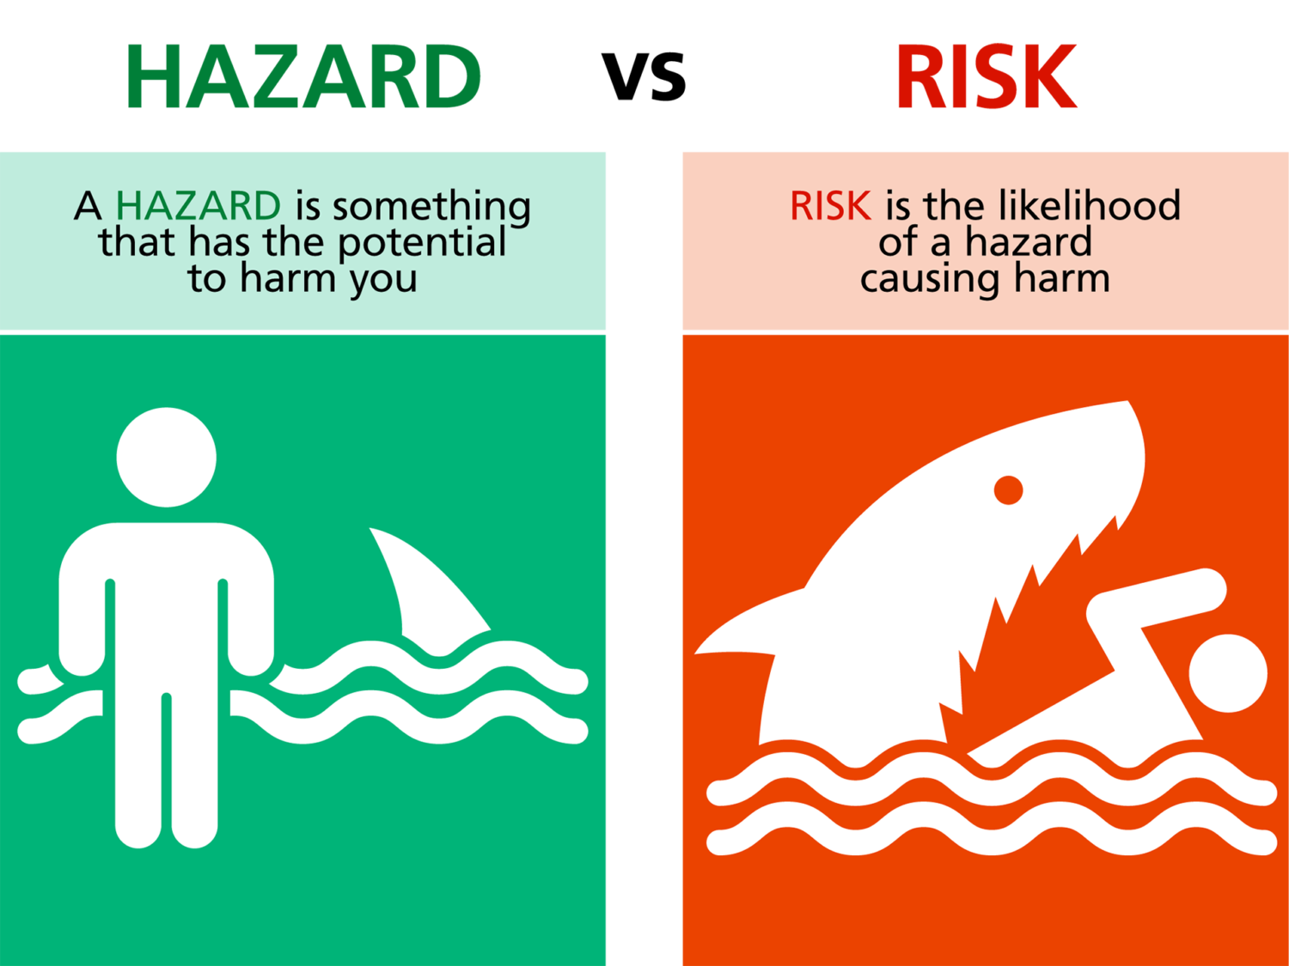
Key definitions
HAZARD
RISK
LIKELIHOOD
SEVERITY
RISK ASSESSMENT
NEAR MISS
UNSAFE ACT
UNSAFE CONDITION
Notes:
ASK GROUP TO GIVE EACH DEFINITION
Hazard – is an article, substance, machine installation, condition or situation with a potential to cause harm or loss, or both.
Likelihood – The chance of a hazard causing harm
Severity – How severe the outcome of the hazard could be
Risk – A combination of the likelihood of a hazard being realised and the severity of the outcome
Risk Assessment – Evaluating risks and deciding if control measures are suitably sufficient to prevent harm/lower severity and deciding on further controls
Near Miss – An incident which didn’t cause harm/damage but could have
Unsafe Condition – Poor condition in the workplace that could result in an incident
Unsafe Act or Omission – Someone’s behaviour or lack of that threatens other peoples safety

Slide 6
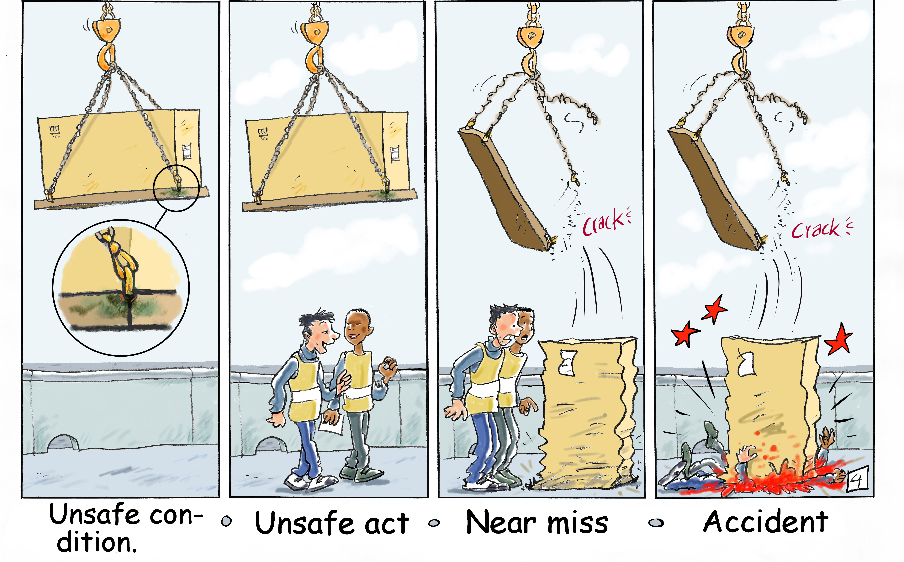
Key definitions
Notes:
Talk through and ensure group understands the difference between each term

Slide 7

Legal Requirements
Health & Safety at Work Act 1974
Management of Health and Safety at Work Regulations 1999
Specific Regulations (e.g. COSHH Regulations 2022)
Risk Assessments must be:
Recorded
Reviewed
Cover all Significant Risks
Suitable and Sufficient
Notes:
HSWA
Section 2 of the Health and Safety at Work Act 1974 implies the need for employers to assess the risks to employees from their work activities, section 3 extends this requirement to non-employees
Section 7 requires employees to co-operate with their employer to enable them to comply with their legal duties
MHSRW
Regulation 3 of the Management of Health and Safety at Work Regulations 1999 clarifies this legal position and states the requirements for conducting ‘suitable and sufficient’ risk assessments for all work activities representing a ‘significant’ risk
Under MHSWR 1999 risk assessments must be recorded for employers of 5 or more employees and reviewed as required
COSHH
Regulation 6 requires employers to have in place suitable and sufficient risk assessments to protect the health of workers exposed to substances hazardous to health
To be suitable and sufficient, the assessment:
Should identify risks arising from the work and allow for their evaluation
Should contain a level of detail and control measures proportionate to the risk
May require the input and advice of specialists
Must consider all those who may be affected by the undertaking
Only needs to identify hazards that are ‘reasonably foreseeable’
Should remain valid over a period of time and enable priorities and due dates to be set
Should be conducted by a competent person

Slide 8
Suitable and sufficient
To be suitable and sufficient risk assessments:
Must identify risks arising from the work and allow for their evaluation
Must contain a level of detail proportionate to the risk
May require the input of specialists
Must consider all those who may be effected by the activity
Only need to identify hazards that are ‘reasonably foreseeable’
Must remain valid over a period of time and enable priorities and due dates to be set for actions
Must be completed by a competent person
Notes:
The person conducting the risk assessment should be:
Competent and have knowledge of the risk assessment process
Be familiar with the work environment and the work activities

Slide 9

Risk assessment objectives
To examine the causes of injury or ill-health
To evaluate where risk control measures and suitable and sufficient
To ensure legal compliance
To protect the production
Notes:
To examine what could cause injury/harm or ill-health and weighing up whether enough is being done to prevent harm or reduce likelihood &/or severity
To ensure legal compliance according to legislation and therefore protect the organisation from legal action
To protect all assets of the organisation therefore reduce financial loss

Slide 10
Five Steps to risk assessment
Identify the hazards
Identify the persons at risk and how they might be harmed
Evaluate the risks and current controls and decide on further precautions
Record significant findings
Review and update as required

Slide 11
1 – Identifying hazards
Hazards can be identified through a variety of methods:
Safety inspections/walks/tours
Past risk assessments
Job or task analysis
Incident data/near miss records
Legislation/HSE guidance
Manufacturers information
Talking with the crew carrying out the work
External specialists (e.g. structural engineers)
Notes:
For job/task analysis talk through SREDIM
Select the Task to be analysed
Reduce the task to steps
Evaluate the risk at each of the steps by identifying the hazards, take into account the existing controls and add in further control measures to reduce the risk
Develop a safe system of work (SSoW)
Implement the SSoW
Monitor and Review

Slide 12
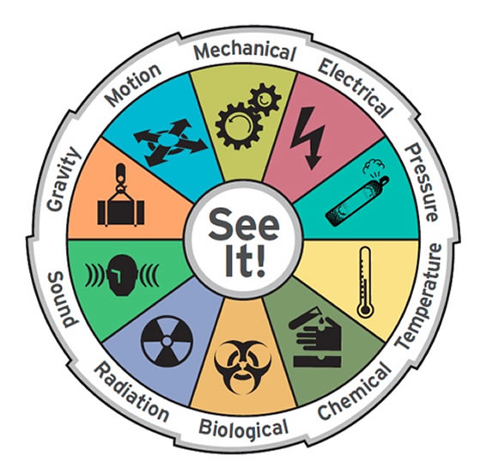
1 – Identifying hazards
Notes:
Can be broadly broken down into:
Physical (safety & health)
Ergonomic
Chemical & biological
Phsycho-social

Slide 13


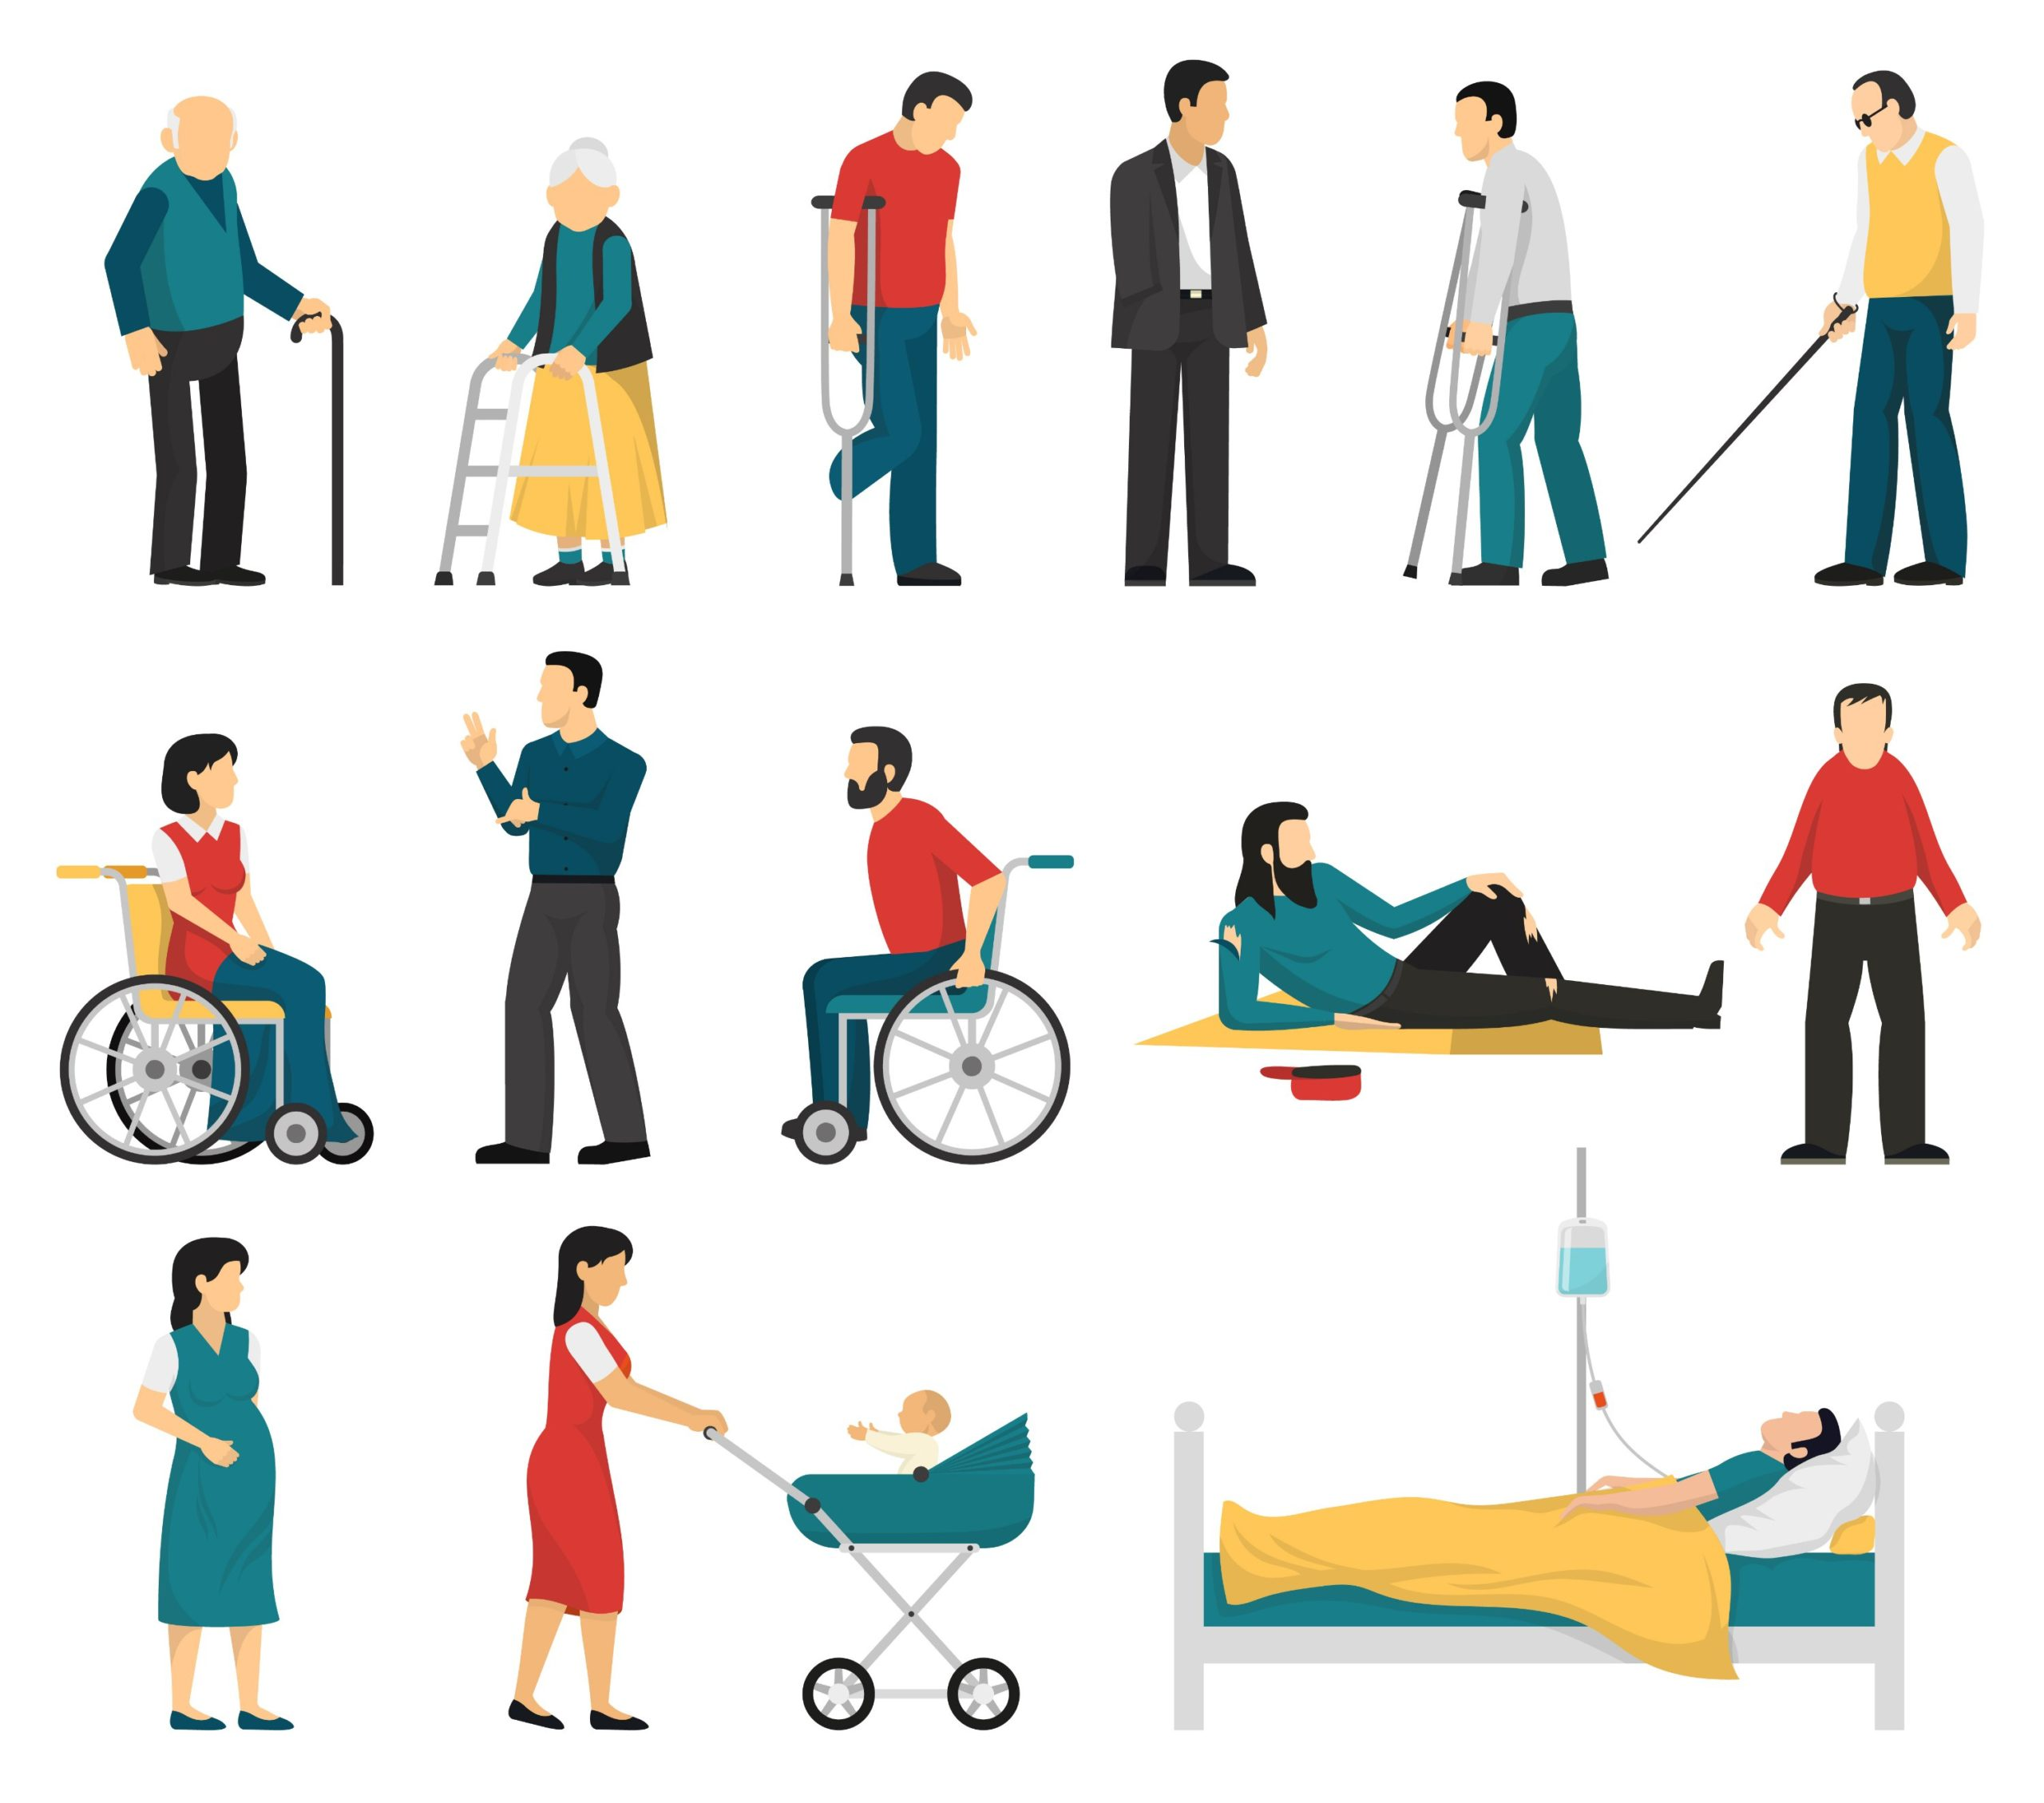
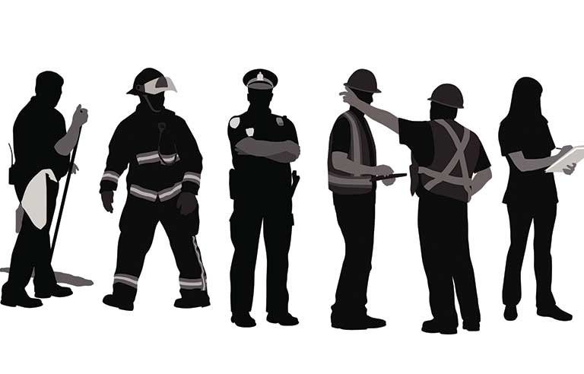
2 – Identify the persons at risk
?
Notes:
Crew
Cast
Contractors/visitors/dailies
High risk roles
Vulnerable persons
Trespassers
Risk assessments must show the risk level for vulnerable persons and the additional actions needed to control the risk, examples of vulnerable persons include:
Pregnant or nursing mothers
Young persons
Disabled workers
Lone workers
May require specific risk assessments for vulnerable persons

Slide 14
3 – Evaluate the risks and current controls
The nature of the hazard – can it kill or seriously injure
Duration and frequency of exposure
Number of persons exposed
Availability of first aid treatment
severity
Duration and frequency of exposure
Competence of persons exposed
The equipment being used and its condition
Number of persons exposed
likelihood
Notes:
The 3rd step involves using the information gathered in steps 1 & 2 to estimate the magnitude of the risk and then evaluate based on current controls as to whether further controls are required.

Slide 15
3 – EVALUATE the RISKS
2 key points to this:
            Risk Estimation
            Risk Evaluation
Notes:
Estimation = magnitude of risk (likelihood & severity) – Calculating Risk Rating
There are various risk evaluation methods, qualitative, semi-quantitative and quantitative
We use a simple matrix of numbers to decide on levels of likelihood and probably severity of harm, a semi-quantitative
The multiplication of these numbers provides a risk rating
Evaluation = Using risk matrix
Considerations when calculating risk ratings and evaluating risks:
Don’t overthink the process, select the most reasonable levels (what is most likely to happen, not worst case scenario)
Consider past injuries, near misses of accidents
Consider the impact of already existing controls
Legal Standards and government (HSE) guidance/ACOPS
Similar industries
Document any additional controls put in place, then calculate residual risk to ensure lowered to an acceptable level
The following should be considered when deciding on any further controls required:
How high is the current risk rather/how robust are the existing controls?
What actual level of risk reduction will you achieve with further controls?
What money, time and resources will be demanded?
Who is going to be responsible for implementing these controls?
Is the risk being controlled ‘so far as is reasonably practicable?

Slide 16
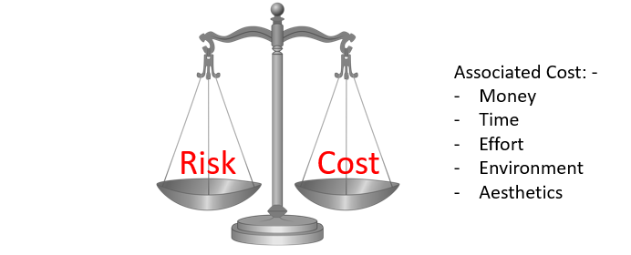
3 – Levels of control
Absolute
Practicable
Reasonably practicable
Notes:
Absolute
Means we have a statutory duty to put in place (e.g. the inspection of fall arrest equipment under Regulation 12 of the Working at height Regulations 2005)
Practicable
In the light of current knowledge and invention we must comply with the legal requirement, regardless of costs associated with implementation (e.g. Regulation 11 of the Provision and Use of Work Equipment Regulations 1998 states machinery must be guarded so far as is practicable)
Reasonably Practicable
The balance of cost versus benefits of risk reduction. A judgement must be made between the risk on the one hand and the sacrifice (in terms of time, effort and money) on the other.

Slide 17
3 – Hierarchy of control (ESEAP)
Technical Measures
Eliminate / Avoid
Substitute
Procedural Measures
Administration
Behavioural Measures
Personal Protective Equipment
Engineering
Notes:
Talk through the principles of prevention:
Regulation 4 of the MHSWR 1999 states where an employer implements preventative and/or protective measures he must do it on the basis of the following principles:
Avoiding the risks altogether
Evaluating the risks which cannot be avoided by carrying out a risk assessment
Combating risks at source
Adapting work to the individual, especially with regards to the design of workplaces, the choice of work equipment and methods
Taking advantage of technological progress which may improve safety
Replacing the dangerous with the non dangerous or the less dangerous
Developing an overall prevention policy
Giving collective protective measures priority over individual protective measures
Giving appropriate instruction to employees.
Another acronym to mention briefly, ERICPD:
Eliminate
Replace
Isolate
Control
PPE
Display / discipline

Slide 18
4 – Record significant findings
Recorded risk assessments should include:
Location or task assessed, department and name of assessor
Date of assessment and review period
Significant hazards associated with the activity and persons at risk
Evaluation of the risks
Identification of existing controls and decision of whether further controls required
Additional controls, who will be responsible and date to put in place
Residual risk level

Slide 19

4 – Record significant findings
All risk assessments should be recorded on the Production safety risk assessment template.
All completed risk assessments should be sent to the production safety coordinator.
The production safety department will maintain a register of all risk assessments across the production.
It is a legal requirement under the MHSWR 1999 to maintain these records.

Slide 20
5 – Review and Update if necessary
The final step is to install a review process to ensure all information remains valid, risk assessments should be reviewed when there is a:
Change of process
Change of personnel
Change of equipment
Change in legislation
An accident and near miss
Complaint by a cast or crew member
At regular intervals (annually)
Following enforcement action

Slide 21
Implementing controls
HODs and supervisors are responsible for ensuring all controls listed on risk assessments are put in place and remain in place.
Copies of risk assessments should be made available to cast/crew.
HODs/supervisors should regularly carry out inspections of their workplaces to ensure controls remain effective.
Notes:
Explain that risk assessments are not just a tick box exercise or a paper exercise to be completed and filled away and forgotten about. They are there to ensure we think about the hazards in our workplace and put controls in place to protect our cast/crew. They will only be effective if those carrying out the activities are familiar with them and understand the controls they should be following. HODs and supervisors have a legal responsibility to ensure those under their control are familiar with the hazards and associated controls in the workplace so must ensure all crew have read and understood the risk assessments related to their work/workplace.
Remind assessors the production safety department is here to support throughout this process

Slide 22
Thank you
Any questions?

